Slide 1



Weekly Meeting
Liri Chen, Shuo Lin, Wenqi Sun, Zhexin Wang, Zixiao Zhang

Slide 2
Initial Timeline
Time | Milestone
Oct 3 - Oct 17 | Baseline, metrics
Oct 18 - Oct 31 | OCR optimization, GPT test
Nov 1 - Nov 14 | Prototype & demo
Nov 15 - Nov 28 | Backend API & UI design
Nov 29 - Dec 16 | Final Presentation

Slide 3
Responsibility
Project Management: Zhexin
Stage 1:
Text - Shuo Liu
Image - Wenqi, Zixiao
Table - Zhexin, Liri
Stage 2:
GPT: Shuo Liu, Liri
Webapp - Wenqi, Zixiao

Slide 4
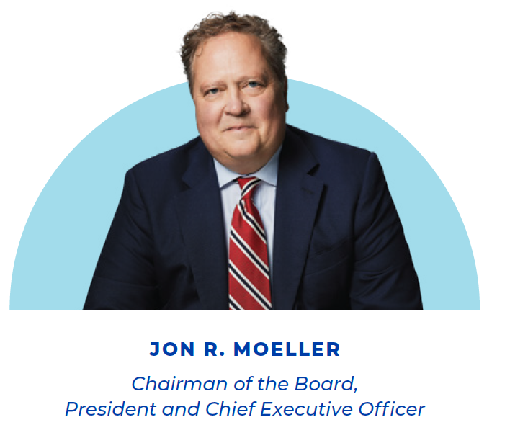
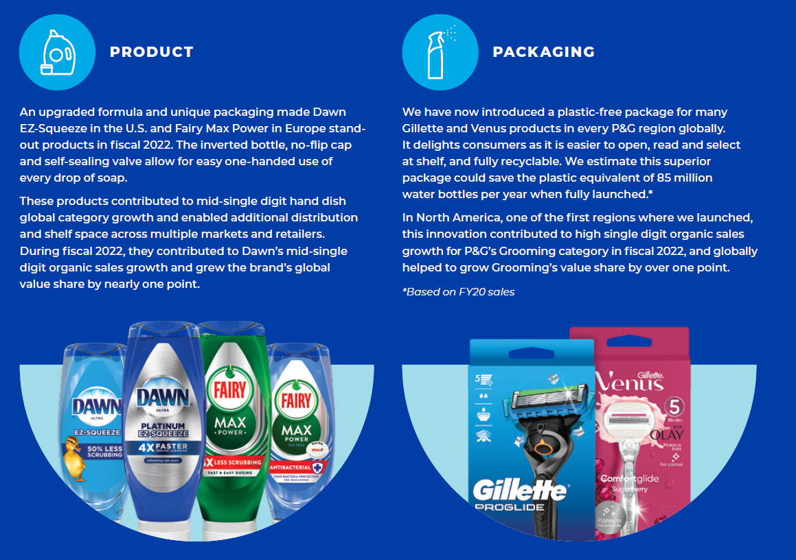
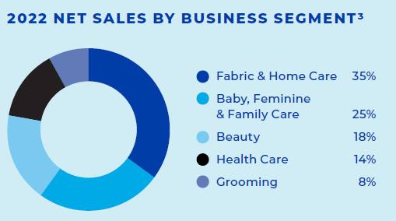
Image Retrieval
We can easily extract all the simple images using some Python Package(pypdf)
Problems
What kinds of information should be paired with images?
How can we match images with extracted texts?
Graphs cannot be extracted in this way

Slide 5
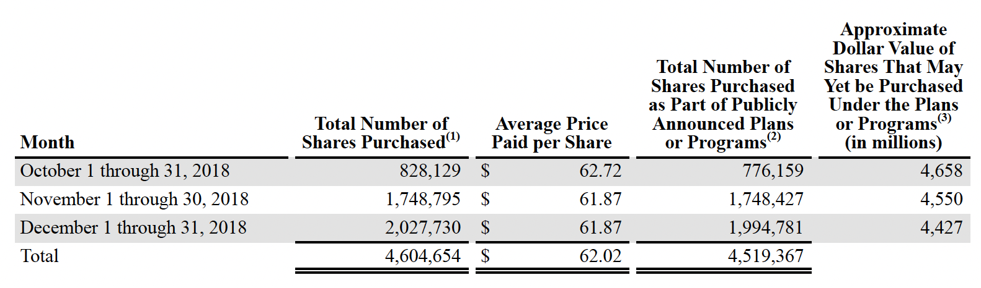
Table Retrieval
Use PyPDF2, tabula-py to extract tables from PDF.
If tables are rendered as image, need to use OpenCV and OCR.

Slide 6
Metrics for Model Evaluation
Character-Level Accuracy: measures the accuracy of character recognition. It calculates the percentage of correctly recognized characters compared to the total number of characters in the ground truth.
Word-Level Accuracy: measures the accuracy of word recognition. It calculates the percentage of correctly recognized words compared to the total number of words in the ground truth.
Edit Distance (Levenshtein Distance): The edit distance calculates the number of insertions, deletions, and substitutions needed to transform the recognized text into the ground truth text. Lower edit distance values indicate better recognition accuracy.
Execution Time: the time it takes to perform OCR on an image is crucial. Monitoring execution time is essential to ensure that the model meets latency requirements.
Confusion Matrix: A confusion matrix provides a detailed breakdown of true positives, true negatives, false positives, and false negatives. It is useful for understanding the specific types of recognition errors made by the OCR model.

Slide 7
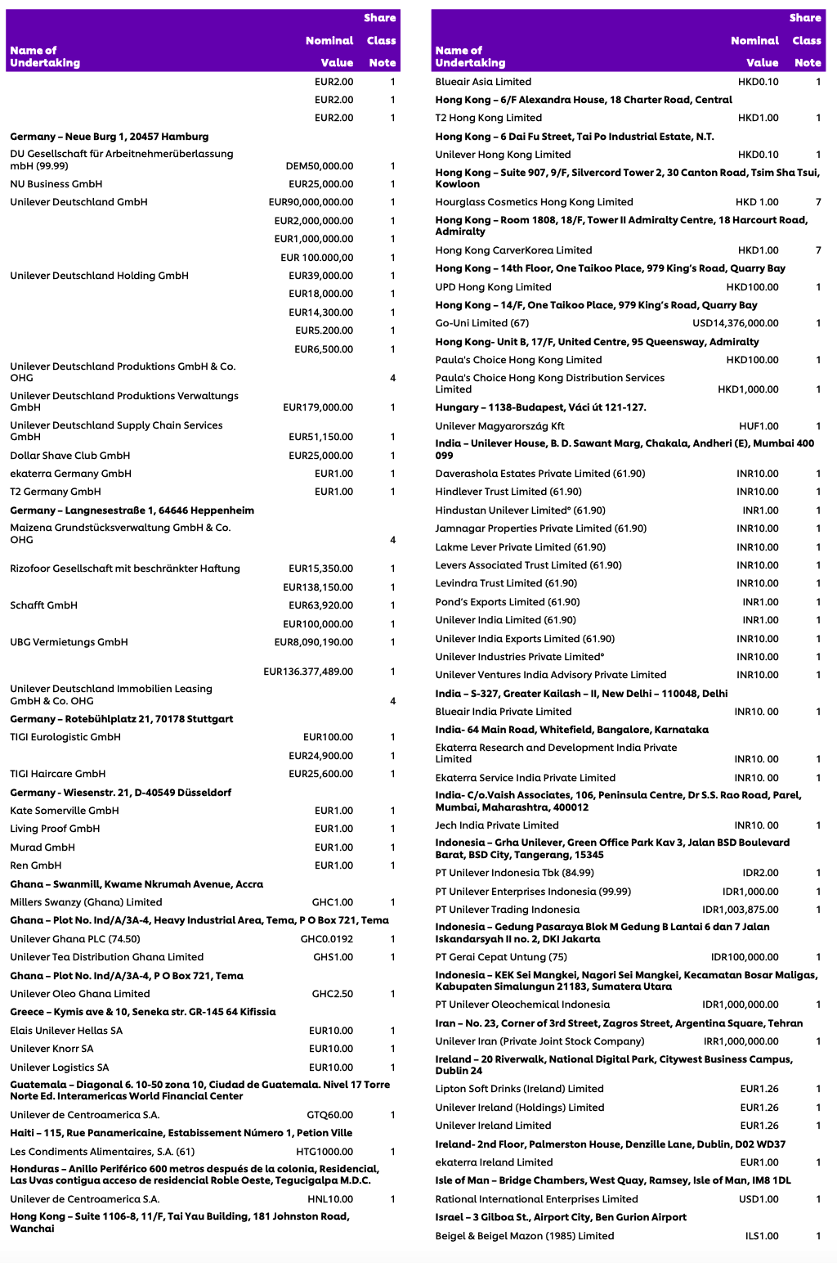
Pytesseract

Slide 8
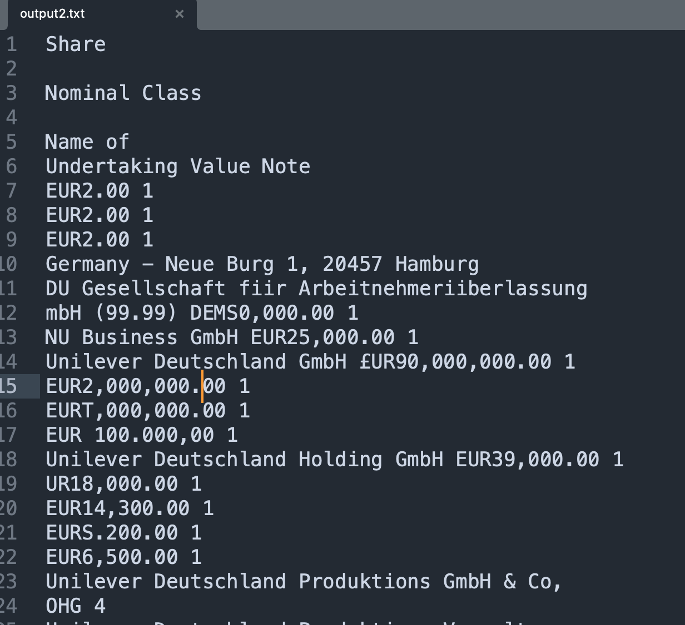
Additional detailed information on our sustainability efforts
including our TCFD (Task Force on Climate-Related
Financial Disclosures), SASB (Sustainability Accounting
Standards Board) and CDP (Carbon Disclosure Project)
reports can be found on _ our website at
https://pginvestor.com/esg. References to our sustainability
reports and website are for informational purposes only and
neither the sustainability reports nor the other information on
our website is incorporated by reference into this Annual
Report on Form 10-K.
Item 1A. Risk Factors.
We discuss our expectations regarding future performance,
events and outcomes, such as our business outlook and
objectives in this Form 10-K, as well as in our quarterly and
annual reports, current reports on Form 8-K, press releases
and other written and oral communications. All statements,
except for historical and present factual information, are
“forward-looking statements” and are based on financial
data and business plans available only as of the time the
statements are made, which may become outdated or
incomplete. We assume no obligation to update any
forward-looking statements as a result of new information,
future events or other factors, except to the extent required
by law. Forward-looking statements are inherently
uncertain, and investors must recognize that events could
significantly differ from our expectations.
The following discussion of “risk factors” identifies
significant factors that may adversely affect our business,
operations, financial position or future financial
performance. This information should be read in
conjunction with Management's Discussion and Analysis and
the Consolidated Financial Statements and related Notes
incorporated in this report. The following discussion of risks
is not all inclusive but is designed to highlight what we
believe are important factors to consider when evaluating
our expectations. These and other factors could cause our
future results to differ from those in the forward-looking
statements and from historical trends, perhaps materially.
impact our business results or financial condition. Further,
we have a significant amount of foreign currency debt and
derivatives as part of our capital markets activities. The
maturity cash outflows of these instruments could be
adversely impacted by significant appreciation of foreign
currency exchange rates (particularly the Euro), which could
adversely impact our overall cash flows. Moreover,
discriminatory or conflicting fiscal or trade policies in
different countries, including changes to tariffs and existing
trade policies and agreements, could adversely affect our
results. See also the Results of Operations and Cash Flow,
Financial Condition and Liquidity sections of the MD&A
and the Consolidated Financial Statements and related Notes.
We also have businesses and maintain local currency cash
balances in a number of countries with currency exchange,
import authorization, pricing or other controls or restrictions,
such as Nigeria, Turkey, Argentina and Egypt. Our results of
operations, financial condition and cash flows could be
adversely impacted if we are unable to successfully manage
such controls and restrictions, continue existing business
operations and repatriate earnings from overseas, or if new
or increased tariffs, quotas, exchange or price controls, trade
barriers or similar restrictions are imposed on our business.
Additionally, our business, operations or employees have
been and could continue to be adversely affected (including
by the need to de-consolidate or even exit certain businesses
in particular countries) by political volatility, labor market
disruptions or other crises or vulnerabilities in individual
countries or regions, including political instability or
upheaval or acts of war (such as the Russia-Ukraine War)
and the related government and other entity responses, broad
economic instability or sovereign risk related to a default by
or deterioration in the creditworthiness of local governments,
particularly in emerging markets.
Uncertain economic or social conditions may adversely
impact demand for our products or cause our customers
and other business partners to suffer financial hardship,
which could adversely impact our business.

